Slide 1
Digital Circuits
Instructor: Engr. Hira Akash

Slide 2
Digital Circuits
Decimal, Binary
Octal, hexadecimal number systems
Conversion of decimal numbers to any other number system and vice-versa
Binary codes,
OR, AND, NOT, NAND, NOR logic gates
Boolean algebra.
Boolean expressions
Simplification of Boolean expression using Boolean algebra.

Slide 3
Digital circuit
A digital circuit is a circuit where the signal must be one of two discrete levels. Each level is interpreted as one of two different states (for example, on/off, 0/1, true/false)

Slide 4
NUMBER
A number is a symbol which is used to express a quantity or amount
NUMBER SYSTEM :
Number system is an organized and systematic way of representing numbers.
There are four types of number system :
1. Binary Number System
2. Octal Number System
3. Decimal number System
4. Hexadecimal number system
BASE :
It is the number of symbols which is available to a number system.
Or,
The number of symbols which is used to express the amount or quantity in a number system is known as base.

Slide 10
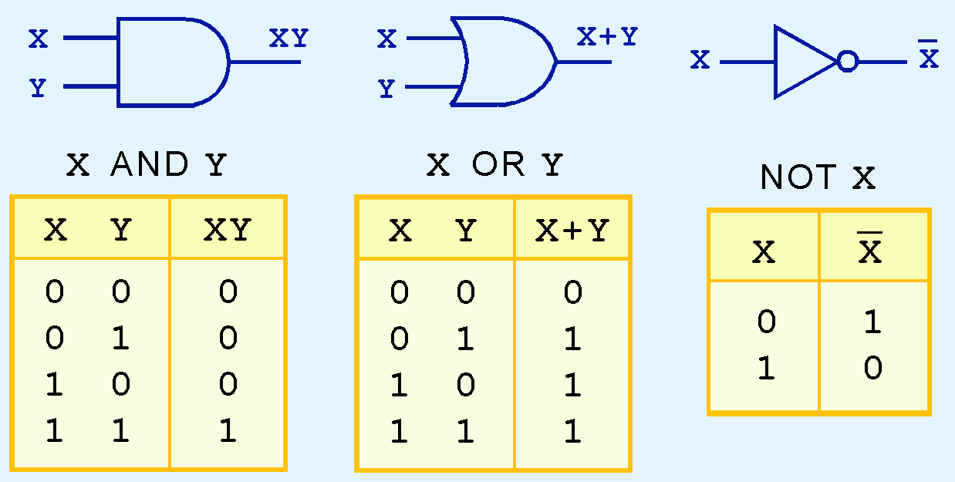
AND, OR, and NOT gates
The three simplest gates are the AND, OR, and NOT gates.

Slide 11
NOT operation

Slide 12
NOR GATES AND NAND GATES

Slide 13
NAND Gate

Slide 14
Summary of Boolean Operations
OR
0+0=0 0+1=1 1+0=1 1+1=1
AND
0•0=0 0•1=0 1•0=0 1•1=1
NOT
1’=0 0’=1 (NOTE THE SYMBOL USED FOR NOT!)

Slide 15
Boolean Theorems

Slide 16
Implementing Circuits From Boolean Expressions
When the operation of a circuit is defined by a Boolean expression, we can draw a logic-circuit diagram directly from that expression.

